Slide 1

Addressing Climate Change
with
Barrier Technology

Slide 2
Greenhouse Gas Meets Concrete
Because - CO₂ is the leading Greenhouse Gas concern
Because - concrete is the 2nd most consumed product next to water (3 tons/person/year)
Because - CAPCELL Patent Pending technology puts CO₂ in Concrete – permanently
THEN - Concrete with CAPCELL becomes the LARGEST single opportunity for REMOVAL of CO₂ – Permanently

Slide 3
Sustainable Concrete
Most good concrete design uses a minimum of 6% void space, historically filled with air
  Required in freeze / thaw climates
  Improved seismic resistance
  Easier to place and finish

Slide 4
Current Air Entrainers for Concrete
Industry wide, concrete producers have settled with the notion that Surfactant Based Air Entrainers (SBAE’s) don’t work. As long as this tolerance maintains it s foothold, Sustainable Concrete is not achievable.
SBAE’s require virtually constant monitoring and adjusting – high resource requirement for limited return as there is still a high failure rate.
A few examples of what affects SBAE’s are: outside temperature (10˚ - 15˚ F ), the size and amount of aggregate (sand and rock), mixing time, order of mixing, adding additional water at the job site . The list is extensive
Some of these factors can completely eliminate the air void space and some can more than double the air void space.
CAPCELL chemistry, Polymer Based Air Entrainer (PBAE), is highly robust relative to repeatable / predictable performance.
CAPCELL is minimally affected by most severe factors and not affected by ordinary factors such as changes in outside temperature.

Slide 5
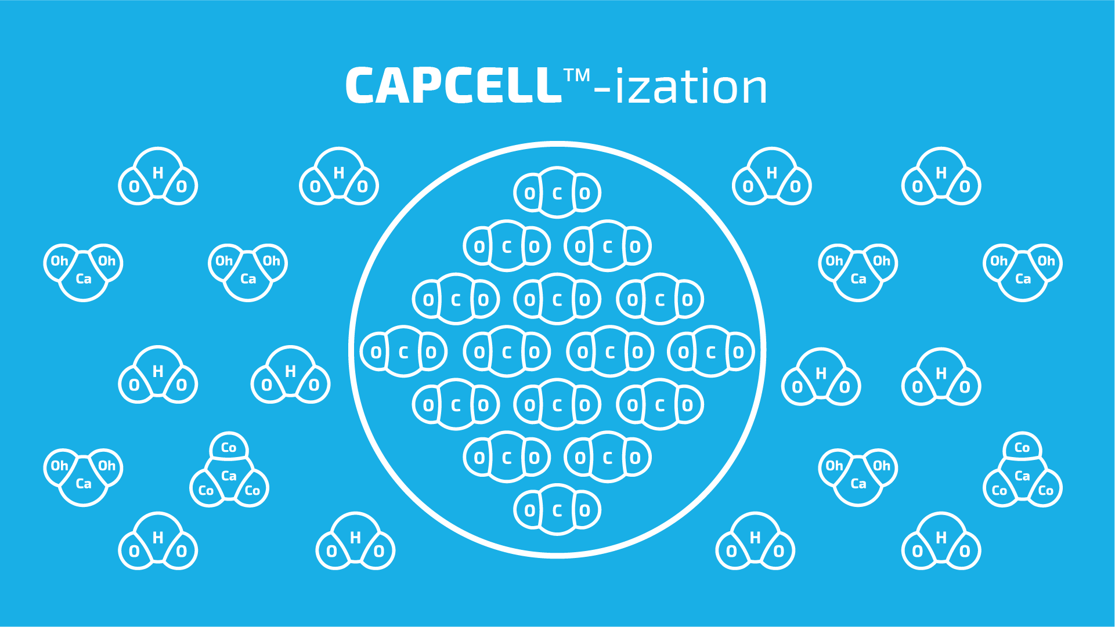

Slide 6
CAPCELL PBAE vs SBAE’s
Polymer Based Air Entrainers
Surfactant Based Air Entrainers
Mechanical (Machine generated)
Non ionic
Large molecular weight
Creates a barrier technology
Consistently ±1% by gas volume
Highly consistent microsphere
Loading based on required void %
Not affected by environmental factors
Agitation
Anionic (typical)
Requires charge to attach (cement) for stabilization
Loading based on the weight of cement
Wide variance of bubble size
High margin of error
Constant Daily adjustment

Slide 7
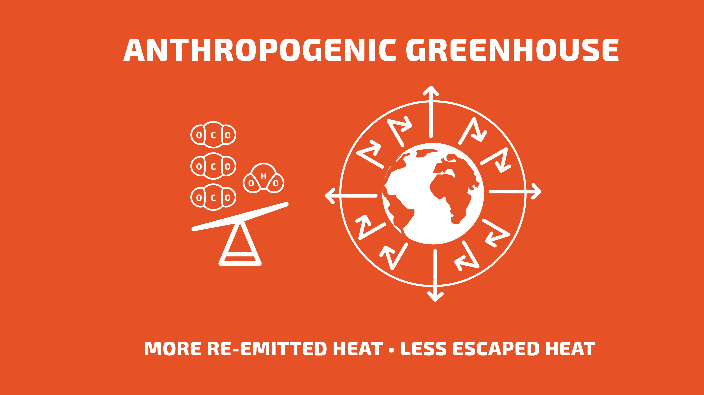

Notes:
Greenhouse effect – based on reflected radiation
More particles – more reflection
Common GHG – water vapor, CO₂, methane, nitrous oxide and various CFC’s.
The greenhouse effect is based on how much radiation is reflected back to the earth and how much escapes the atmosphere. As the CO₂ levels increase, there is more particles to hold and reflect the radiation back causing an increase in temperature.
Common greenhouse gases are water vapor, CO₂, methane, nitrous oxide and various CFC’s.

Slide 8
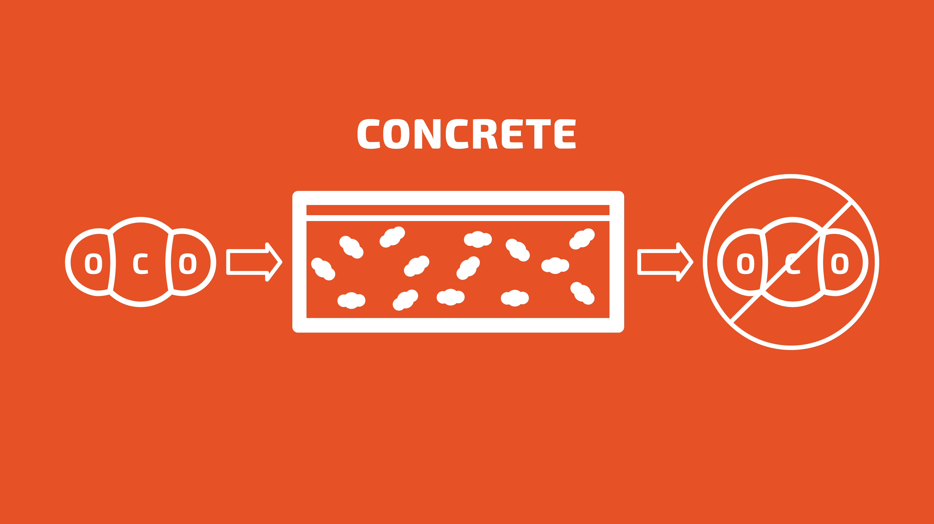
Notes:
The CO2 engages in the concrete chemistry completely eliminating the CO2 from the planet.

Slide 9
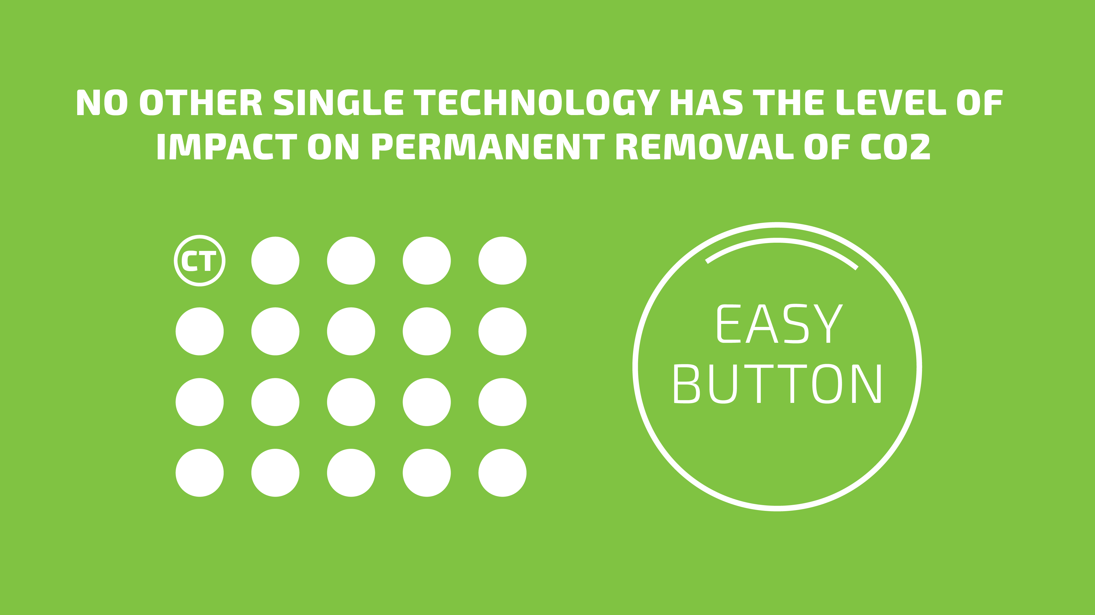
Notes:
No other single technology has the level of impact on permanent removal of CO₂
No baggage. Every level of engagement benefits including the consumer and the general population.
Barriers to entry are nominal. An average concrete plant requires a capitalization of $5 million. Implementing our technology requires a $20,000 machine that integrates into the current operation with no other changes required. No change in process, materials or equipment. Globally!
Commercially available now
Generates superior concrete
By you enabling CapCell technology, it is equivalent of removing 2.5 million cars from the road per year.
CellTech is equivalent to over 80% of the large scale integrated CCS projects graphed previously

Slide 10
Notes:
With CO2 there is only 2 results – carbonic acid or calcium carbonate

Slide 11
WITH INDUSTRY ADOPTION
The Annual Capacity of CAPCELL technology for removing CO2 is equivalent to:
  Removing 2.5 million cars from the road
  A 4” pipeline to the moon and back - 1000 times
  Filling 2.9 Trillion ½ liter water bottles
  Concrete with CAPCELL becomes the LARGEST single opportunity for REMOVAL of CO2 - Permanently

Slide 12
Developed by Miracon Technologies, LLC
WWW.MiraconTech.com

