Slide 3
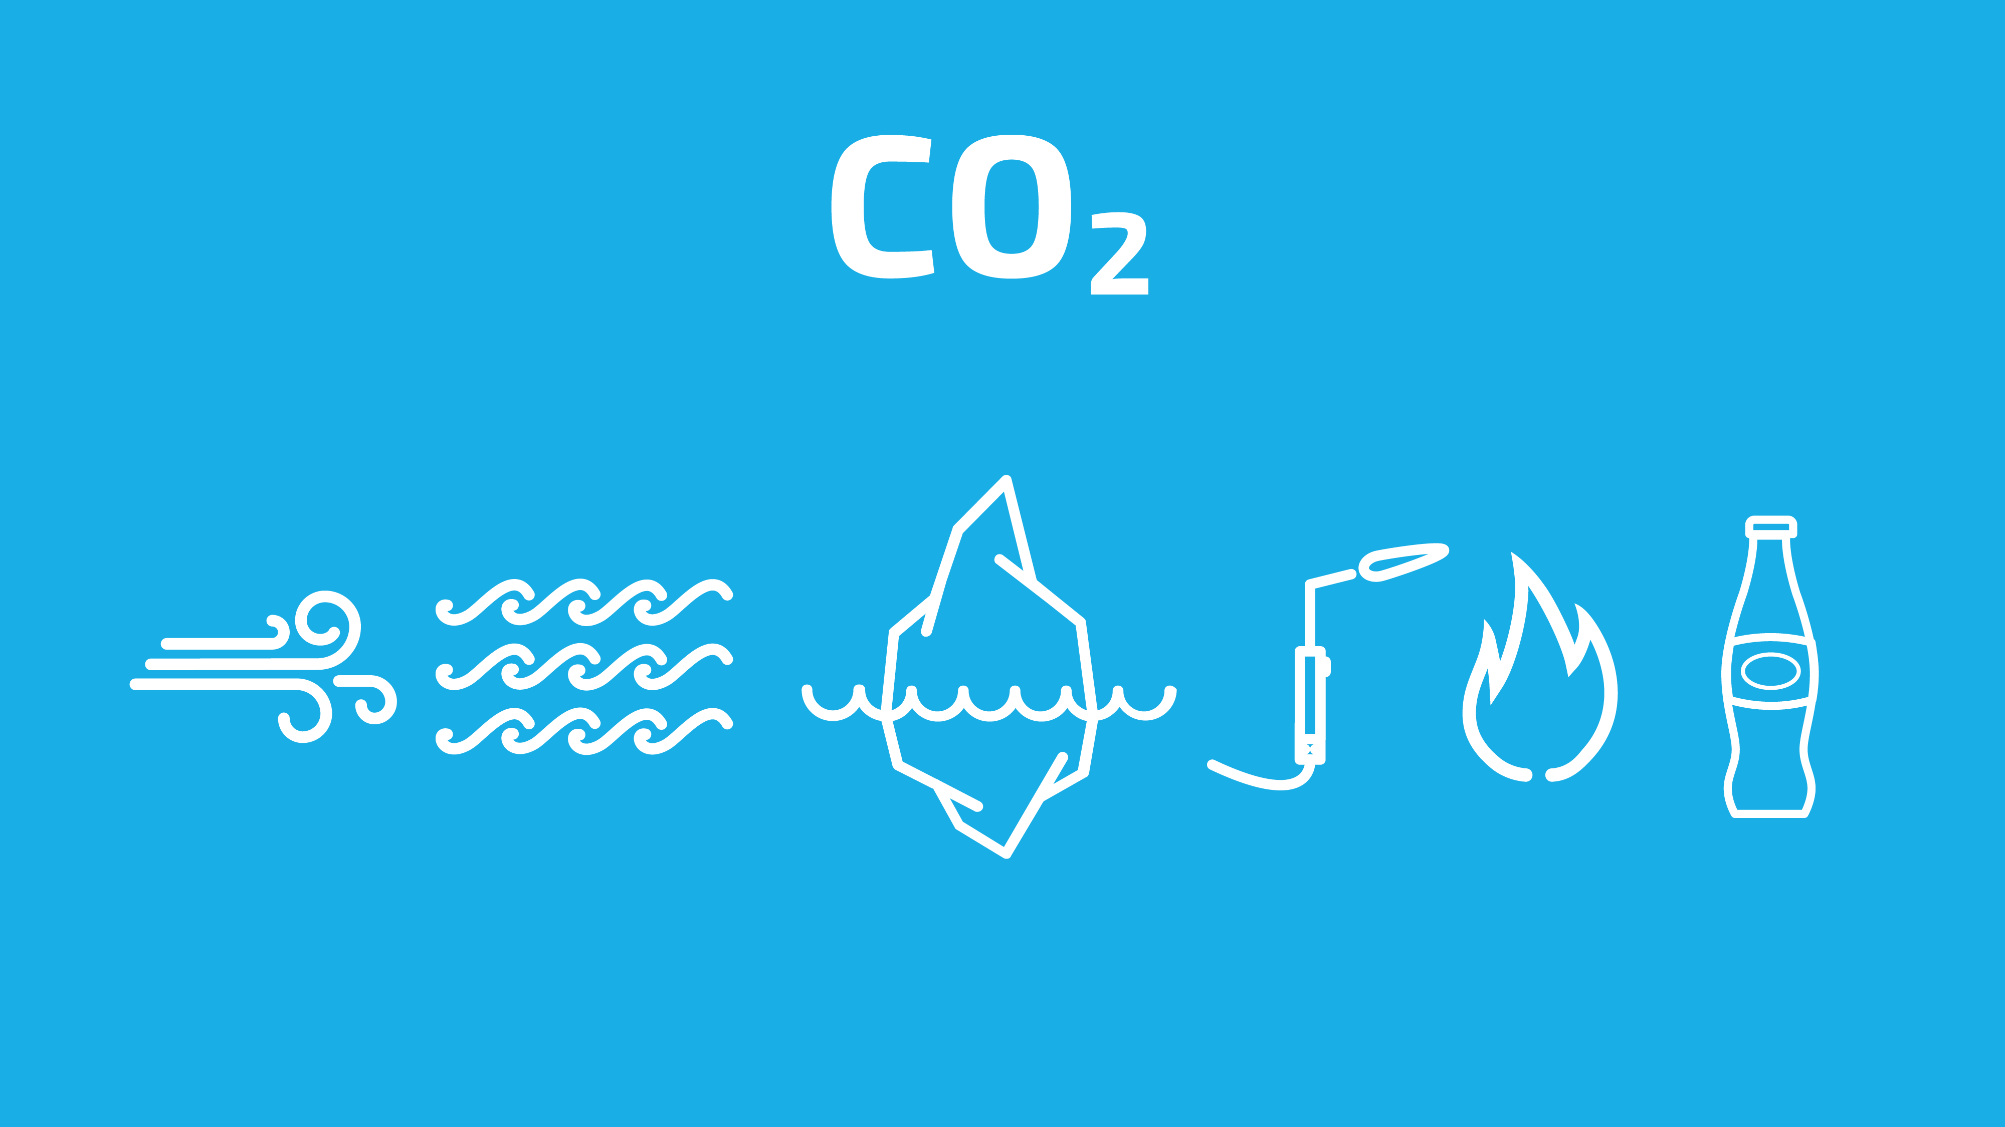
Notes:
Short speak on CO₂
CO₂ - vital to our existence
Naturally
Beer and Soda!
CO₂ in the right quantities is vital to life on Earth. It occurs naturally in many places and conditions. All aerobic organisms produce CO₂ in respiration (breathing). It can be found naturally in our atmosphere, all groundwater, rivers lakes and oceans. It is in the ice caps, glaciers, and most petroleum products. It is used in welding, oil recovery, solvents and drying agents. It is a by product of fermentation and decay of organic materials. It is produced in most combustion processes from burning wood to gasoline.
Most importantly we use it to make our beer and soda worth drinking!

Slide 4
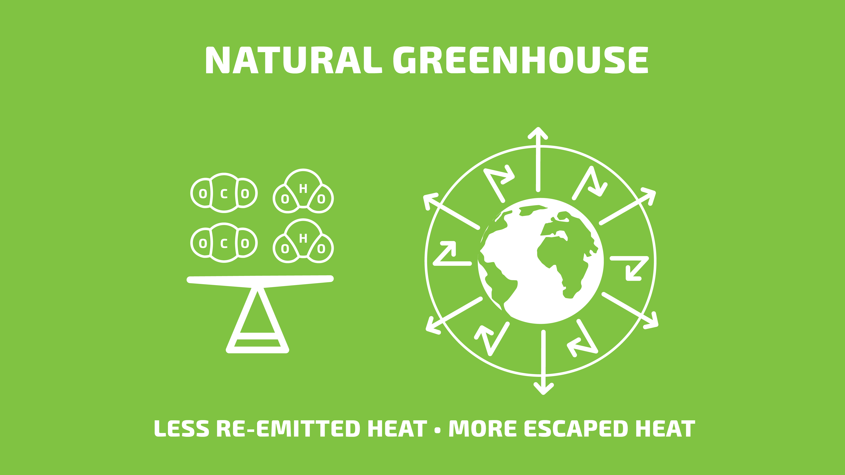
Notes:
Ask if they want Greenhouse Effect explanation
Atmosphere produces the Greenhouse effect
Long wave radiation
GHG is balance at 250 – 300 ppm
Would anyone like me to quickly run through the Greenhouse effect?
Our atmosphere produces the Greenhouse effect. Radiation from the sun is absorbed through the atmosphere into the earth. Long wave radiation is projected from the earth and absorbed by Greenhouse Gas molecules such as CO₂ and re emitted in every direction. When the Greenhouse gases are in balance as they have been for close to a million years, there is roughly 250 to 300 ppm of CO₂ in the atmosphere which absorbs and re emits the long wave radiation at an amount to produce stable temperatures.

Slide 5
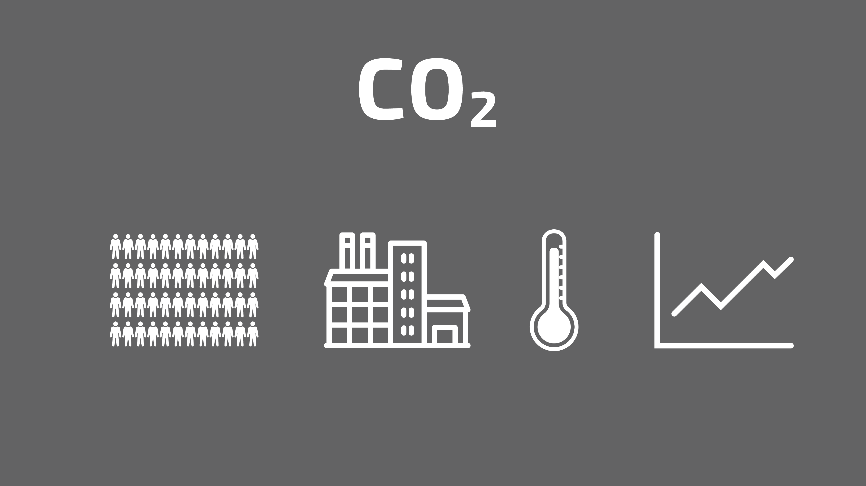
Notes:
Too much
Population growth / industrial revolution
Anthropogenic
Ocean acidification
Ecosystem – max 450 ppm – 3C
Too much of good thing usually turns bad. Our world has grown dramatically in population and industrialization over the past 200 years and we have pushed the CO₂ to a dangerous level of slightly over 400 ppm. This is considered anthropogenic CO₂ (produced by humans) and is a leading reason for global warming. It is also a major cause of ocean acidification because it dissolves in water to form carbonic acid. Our understanding is the ecosystem cannot withstand more than 450ppm which relates to a 3⁰ C temperature change.

Slide 6
Notes:
Greenhouse effect – based on reflected radiation
More particles – more reflection
Common GHG – water vapor, CO₂, methane, nitrous oxide and various CFC’s.
The greenhouse effect is based on how much radiation is reflected back to the earth and how much escapes the atmosphere. As the CO₂ levels increase, there is more particles to hold and reflect the radiation back causing an increase in temperature.
Common greenhouse gases are water vapor, CO₂, methane, nitrous oxide and various CFC’s.

Slide 7
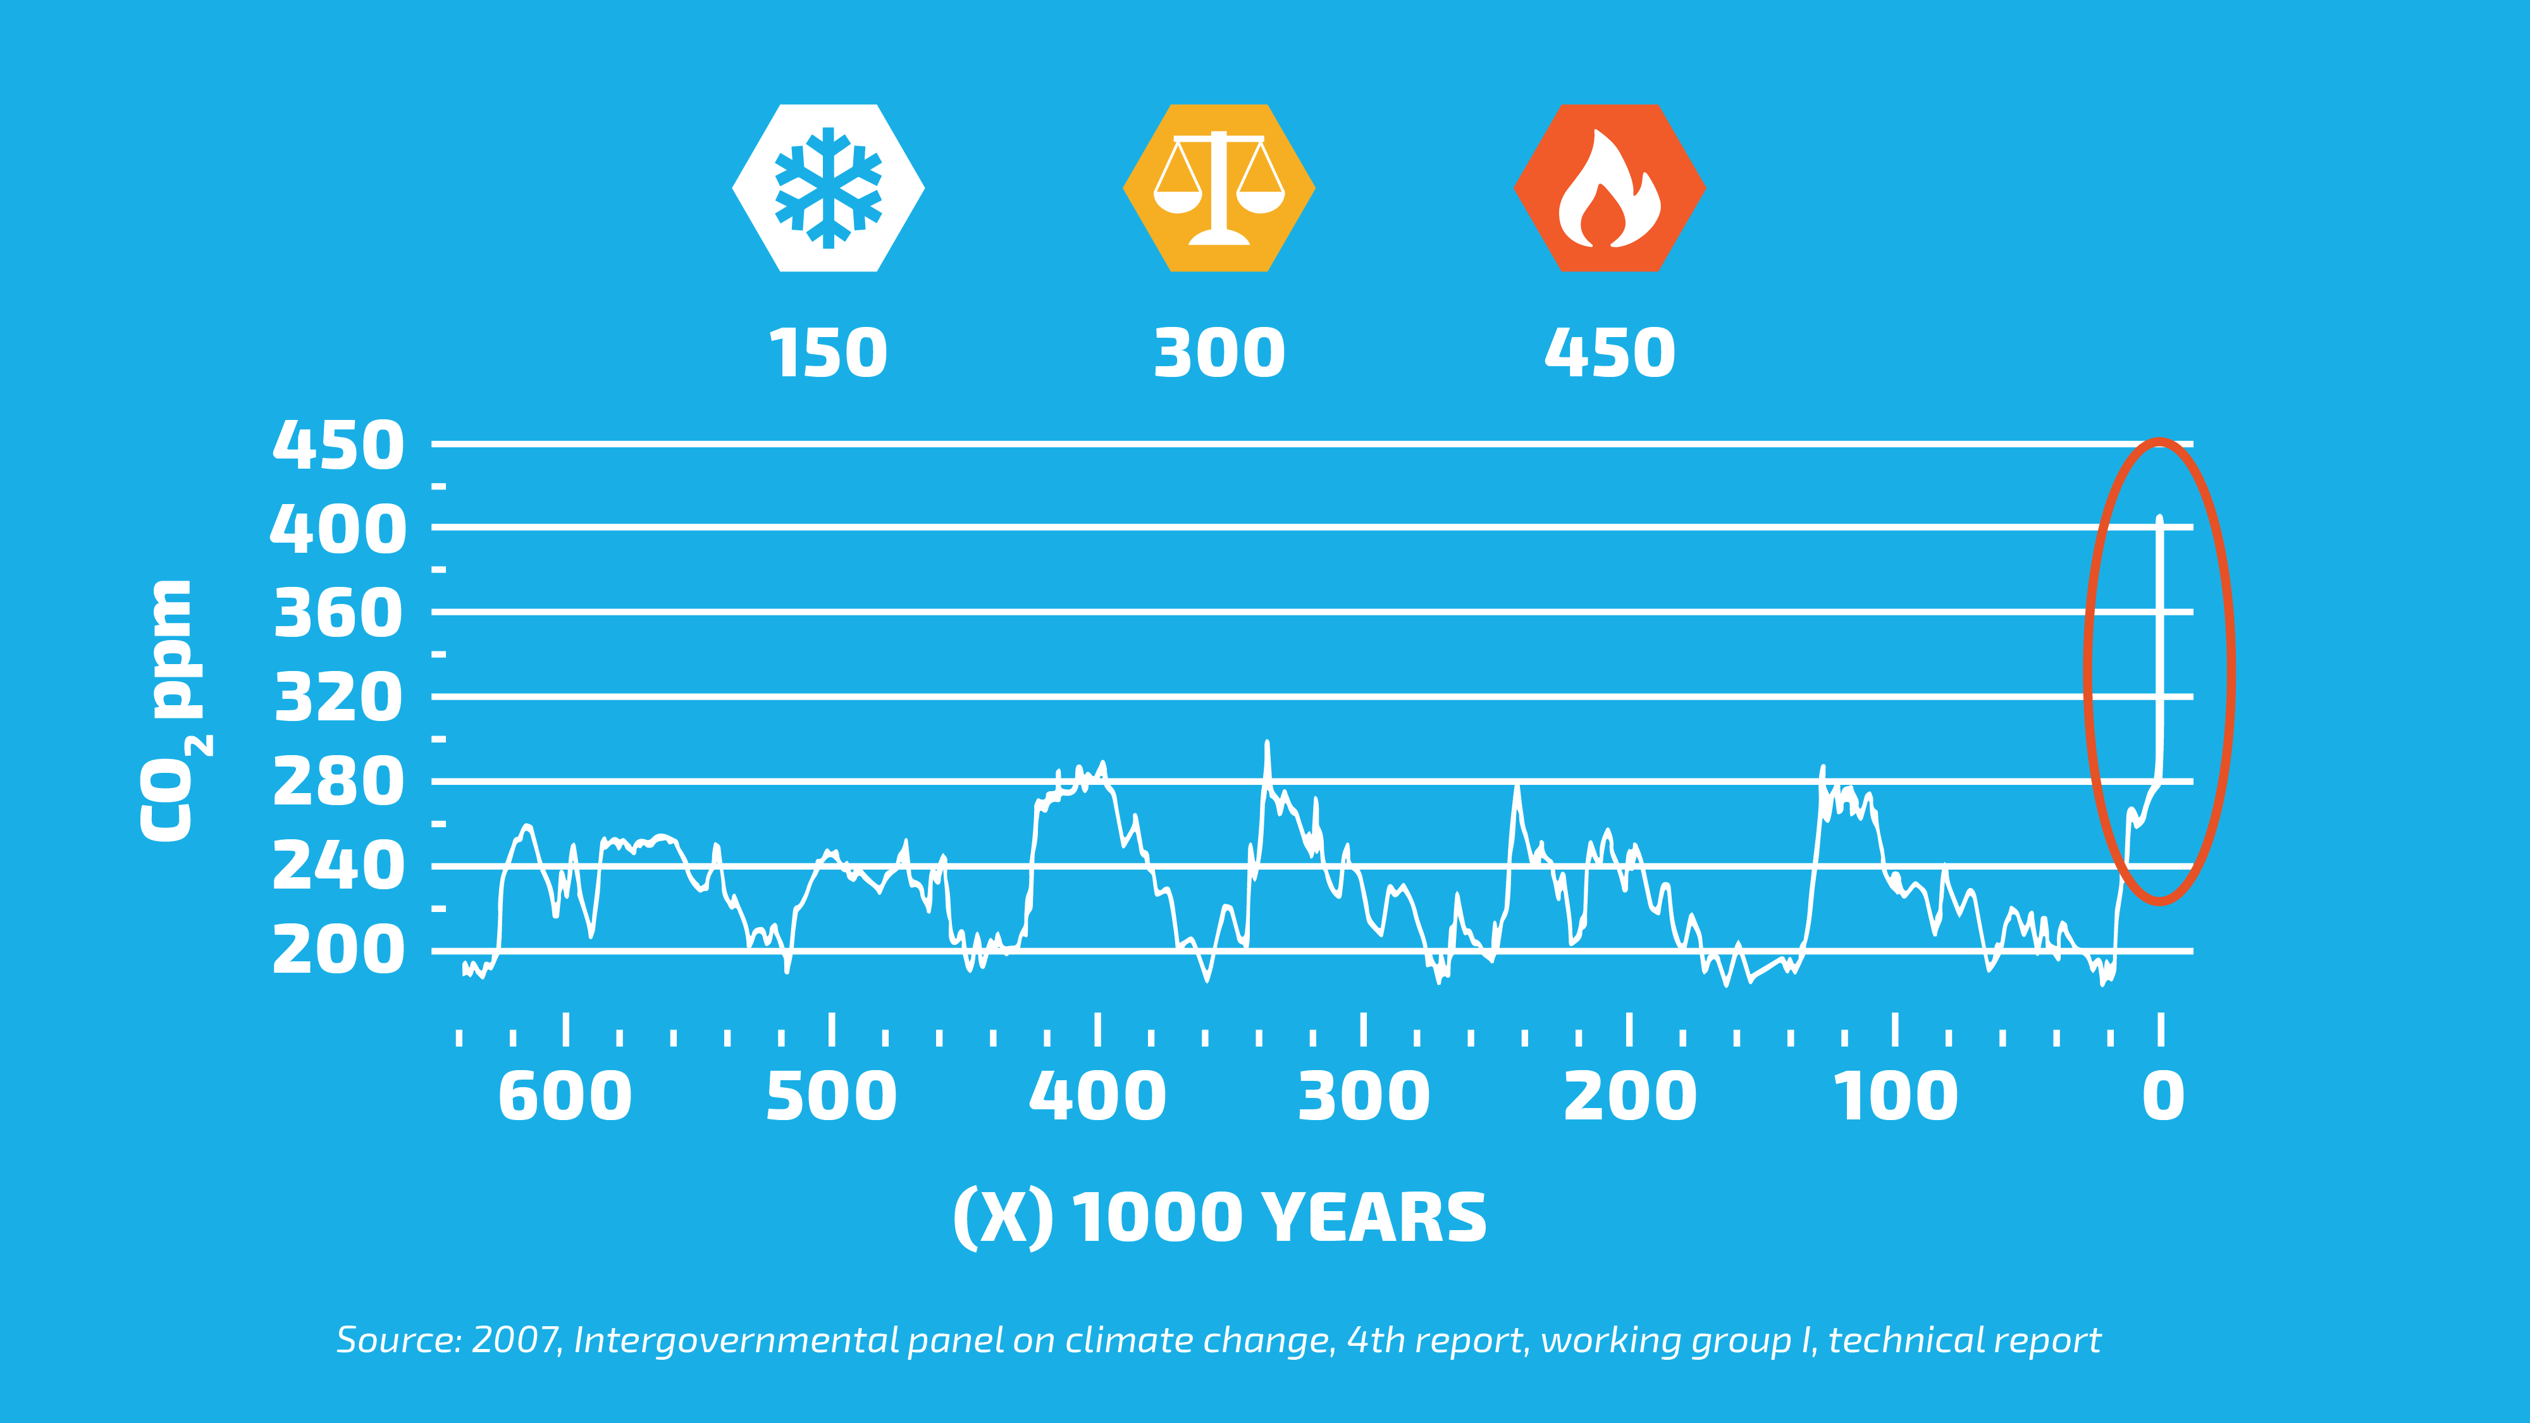
Notes:
Charlie has monitored CO₂ levels for past 600,000 years
Consistently less than 300 ppm
As can be seen, CO₂ levels ranged below 300 ppm until very recent times. This was personally monitored by Charlie for over 600,000 years.

Slide 8
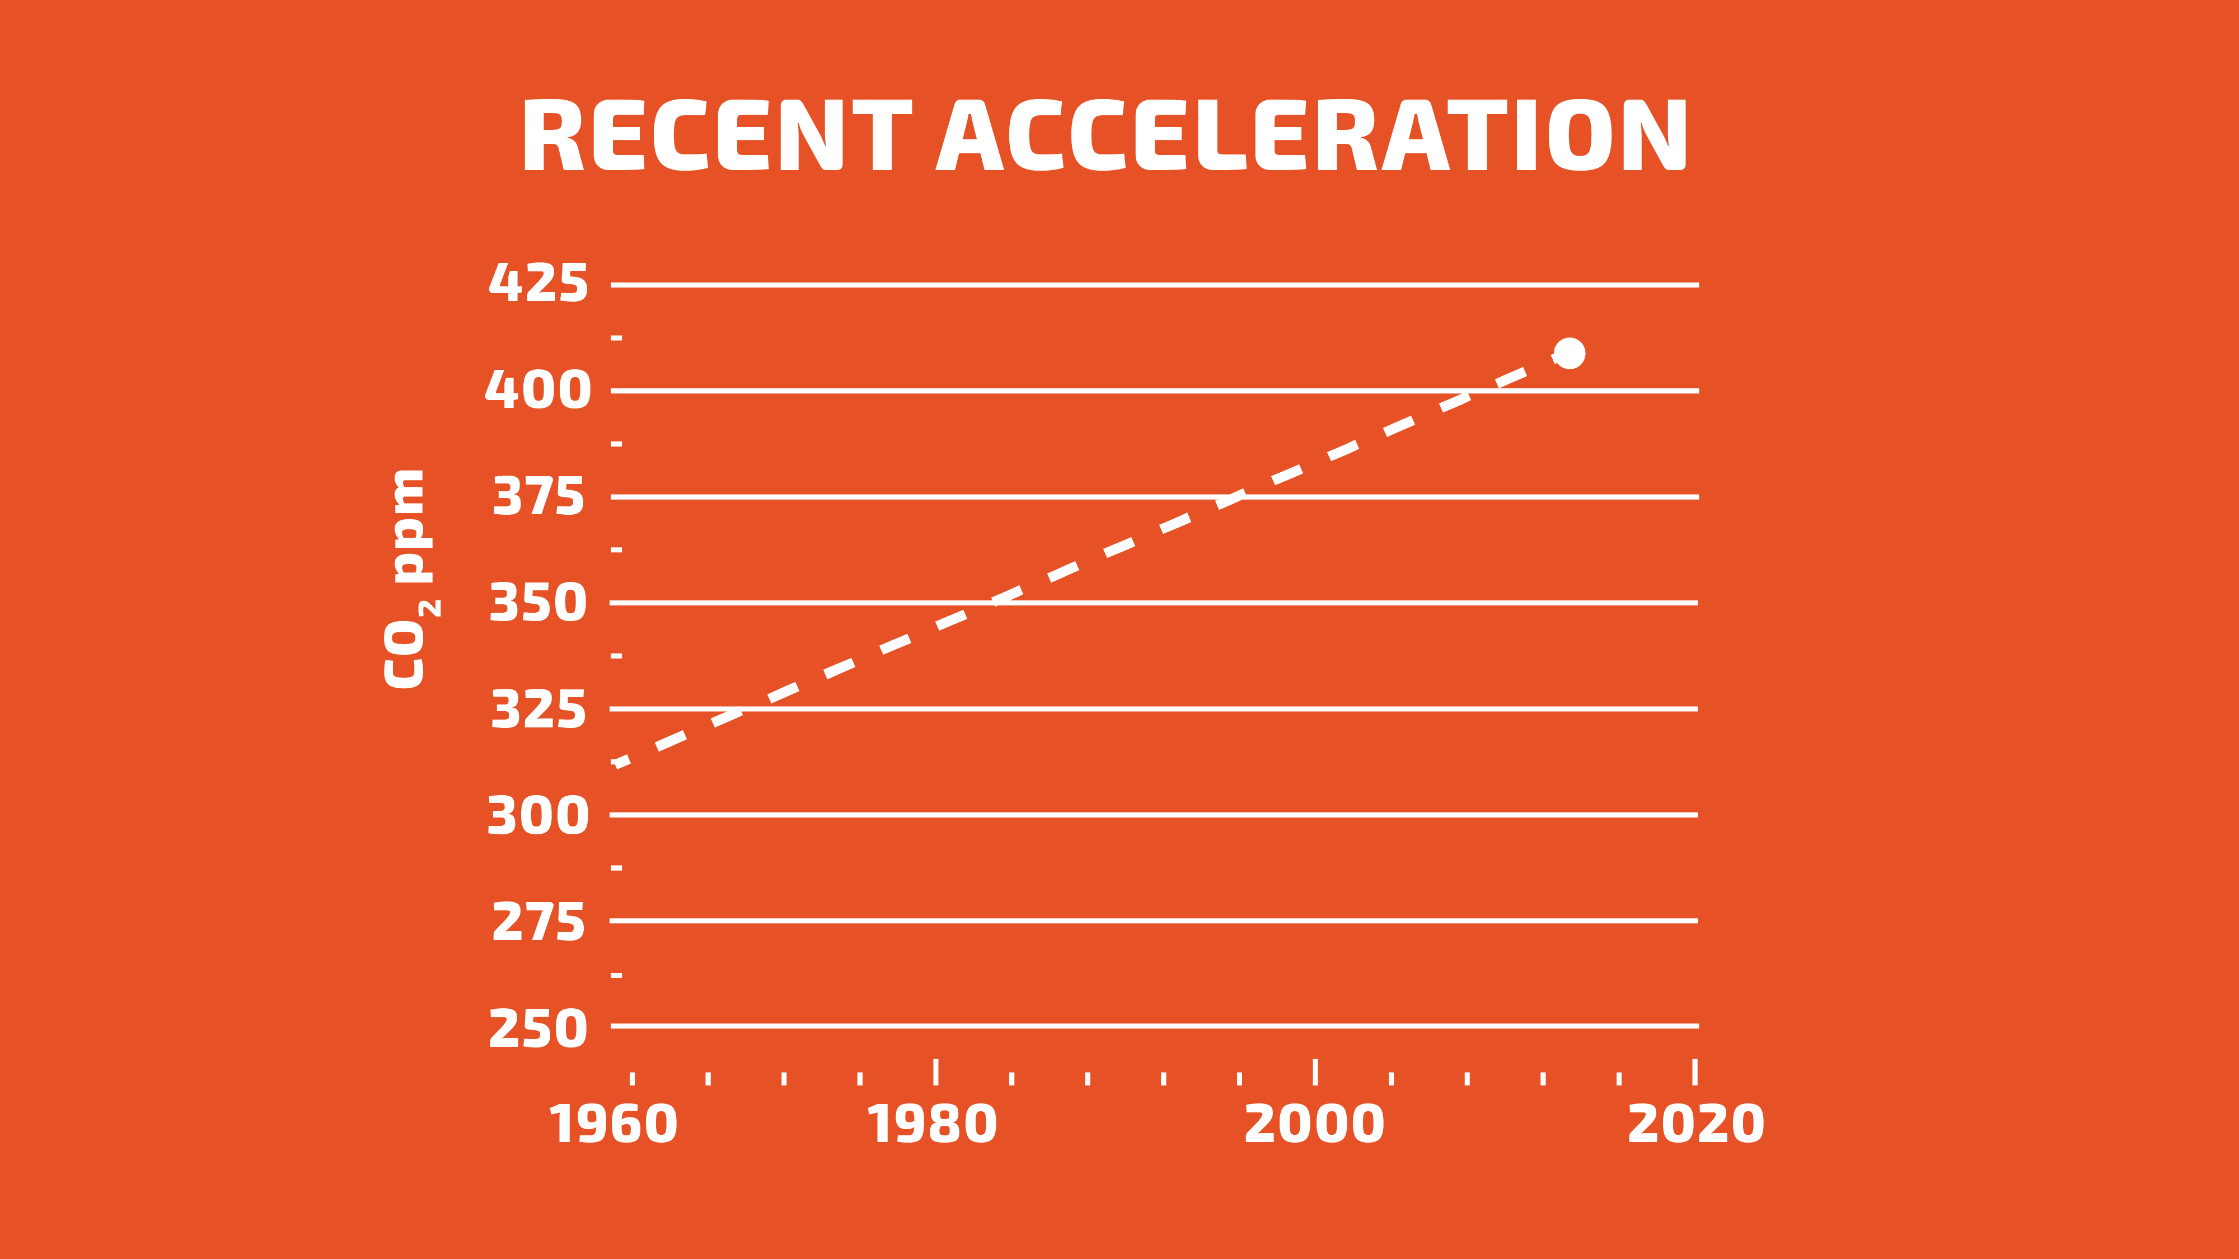
Notes:
Alarming change
This shows the alarming change in CO₂ levels over the past 56 years. A net increase over 30%
One reference is:
As of June 6, 2016, the measured CO₂ level was 407.7 ppm as per www.CO₂.earth

Slide 9
Notes:
There are two camps, both important, in this target.
Prevention of CO₂ production – (forward looking)
Reduction of Current CO₂ levels – (Historical and current)
Prevention of CO₂ production – (forward looking)
Focus on prevention of CO₂ production is beneficial and necessary. One of the keys to acceptance of forward thinking is always education.
Reduction of the use of fossil fuels is one key to the ultimate reduction of anthropogenic CO₂. This involves building better technologies such as more efficient vehicles, utilizing alternative fuel sources, better batteries, and reducing our dependence on materials such as plastics.
San Francisco has banned water bottles, plastic bags and now Styrofoam
Implementation of strong recycling programs, while expensive to implement as any new process or technology, has significant return for future generations.
Much effort is in place to restrict or define allowable emissions enforceable by fines and regulatory requirements. Commonly known ones are the Paris Accord and the Kyoto Protocol. The US EPA has vehicle GHG rules and Clean Power Plans for power plants.
Initiatives such as Earth Day are focused on bringing environmental and technological sectors together for the benefit of all.
Current efforts (others)
The lists are endless for groups taking up the flag focused on GHG reductions. A few examples are:
Cool Effect https://www.cooleffect.org/content/about-us/faqs/
Net CO₂ reduction 5,310 Tonnes
Partners for Climate Protection http://www.fcm.ca/home/programs/partners-for-climate-protection/program-resources/greenhouse-gas-reduction-initiatives.htm
Center for Climate and Energy Solutions http://www.c2es.org/us-states-regions/regional-climate-initiatives/mggra (Midwest Greenhouse Gas Reduction Accord)
California Air Resources Board (Calif EPA) http://www.arb.ca.gov/cc/cc.htm
Assembly Bill 32 – Global warming solutions act.
Texas – Texas Climate & Carbon Exchange – opened in 2012

Slide 10
Notes:
Montreal protocol
Kyoto Protocol
Plants and trees – immediate benefit
Underground Storage
Reduction of anthropogenic CO₂ – (Historical and immediate impact)
The Montreal Protocol was ratified by 196 countries and the EU. It’s mandate is to reduce substances that deplete the Ozone layer. It went into enforcement in 1989 and is considered to be the most successful international agreement to date. The net results should return Antarctic ozone to 1980 levels between 2050 and 2070.
Planting more plants and trees is very beneficial in the moment. However it no longer qualifies for carbon credits because when the plant or tree is cut down, it off gases the CO₂ it captured. Therefore it is not permanent.

Slide 11
Notes:
Mandate!
100’s of brands
Unilever hovers at the 150 as a Fortune 500 company. They have a written mandate to be carbon positive in all operations by 2030 (14 years)
Unilever https://brightfuture.unilever.us/stories/473119/take-climate-action-for-a-bright-future.aspx?gclid=COfb3bqn1c0CFQMQaQodkrYEIA&gclsrc=aw.ds
Unilever has 100’s of brands

Slide 12
Notes:
Concrete – v. low carbon footprint per unit
Volume gives CO2 levels
Volume is our lever
Building and construction is accelerating with the development of the middle class particularly in India and China. Therefore the use of building products is expected to increase over the next 30 years.
If we look at building products on a per unit basis, it shows that concrete has a very low carbon footprint.
So why wouldn’t we take a run at aluminum or even lumber instead of concrete?
Concrete actually holds the keys as it is the largest consumed building product in the world. The average today is 4 tons per person per year.
Concrete gets the rap as being a major contributor to CO2 emissions due to the shear volume placed
It is also the reason that it makes the most sense to utilize concrete with our technology because we have an enormous footprint to work with.

Slide 13
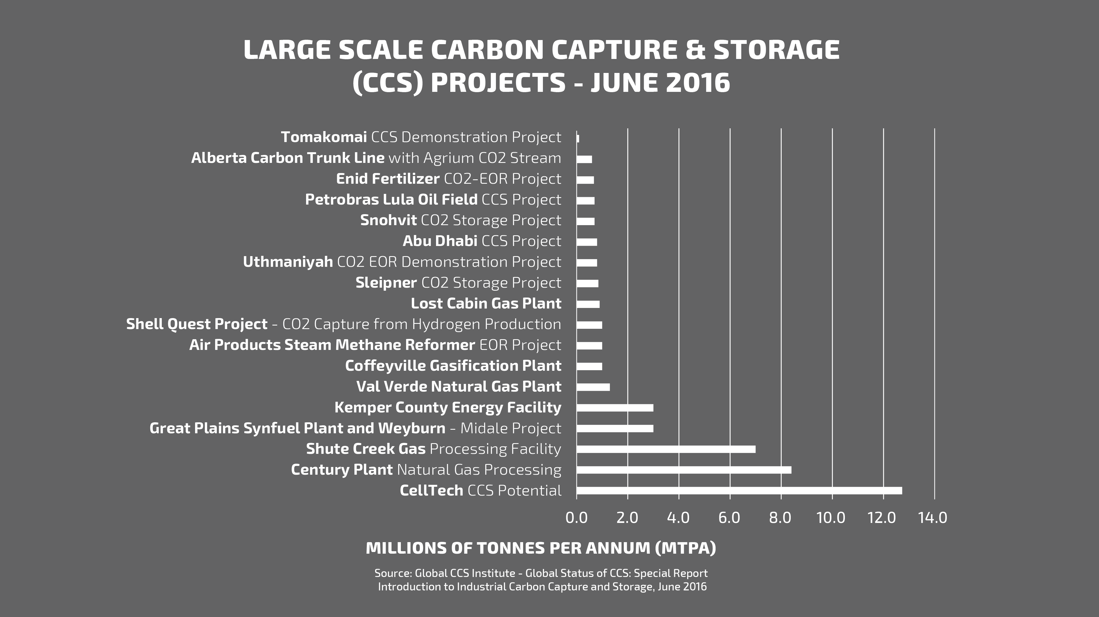
Notes:
CCS – large point
17 projects
Underground storage
Large-scale integrated CCS projects (LSIPs) are defined as projects involving the capture, transport, and storage of CO₂ at a scale of:
at least 800,000 tonnes of CO₂ annually for a coal–based power plant, or
at least 400,000 tonnes of CO₂ annually for other emissions–intensive industrial facilities (including natural gas–based power generation).
Carbon capture and storage (CCS) of GHG gases from large point sources such as fossil fuel power plants started in 1972 with the first commercial application. The CO₂ is then injected into geological formations for various purposes – Enhanced Oil Recovery – EOR. Inefficiencies in capture, handling and injection yield roughly a 50% CCS ratio.
CCS large point sources now have 17 major projects that have captured in excess of 100 million tons of CO₂ to date. These projects break down in five major areas; Natural Gas Processing, Fertiliser production, Hydrogen production, Coal gasification, Iron and steel making. All of these utilize deep underground storage or EOR.
http://www.globalccsinstitute.com/content/industrial-ccs

Slide 14
Notes:
CellTech – 12.7 MTpA
The 17 current and about to be launched CCS projects which are the largest in the world, utilize underground storage.
All but one. One company stands out “CellTech”
CellTech PERMANENTLY removes CO₂
CellTech utilizes concrete, the second largest consumed product in the world next to water at 4 tons per person per year, globally.
We tether it to CO₂, the largest GHG
And we make better concrete with it.
Due to the nature of CellTech technology and the interaction with concrete, CO₂ is permanently removed by a chemical reaction.

Slide 15
Notes:
This is the technology
Bubble!
Rheology and compaction
Good Rheology yields good compaction
Concrete mix of crusty materials
CellTech (CapCellize) - CapCellizing CO₂ in a polymer bubble.
CellTech utilizes science to manage Rheology and Compaction in fluids. (flow and structure)
Rheology – how materials move
Compaction - the act of compacting or the state of being compacted
Good rheology yields good compaction properties.
Standard concrete is a mix of rocks varying in size, sand, water and cement and chemicals. Cement is a flat particle and rocks are all kinds of shapes. When you put all this together, it is naturally difficult to stir or mix. Each one of these materials drag and cause high friction, and when combined, it is no better.

Slide 16
Notes:
The CO2 engages in the concrete chemistry completely eliminating the CO2 from the planet.

Slide 17
Notes:
CapCellize CO₂
Prevent chemistry
CO₂ and concrete
Proper timing
How Does it Work?
We CapCellize CO₂, and our patent pending technology manages the CO₂, limiting it from engaging in the normal reactions with concrete and water.
The concrete industry has been working on successful utilization of CO₂ in concrete for over 50 years.
When CO₂ prematurely interacts with concrete in the wet stage, it combines with the water and forms carbonic acid. This reacts with the calcium carbonate and generates significant heat and affects the pH. The concrete, if it sets at all, will be brittle and have poor final properties.
Our system engages the CO₂ at the proper time so we have a neutral or slightly positive effect on the final properties.
AND our bubble is pressurized and contains 4 times the CO₂ found at atmospheric conditions.

Slide 18
Notes:
Hydrophilic & hydrophobic
Low friction
Wetting – consistency of material behavior
homogenous
Rheology Modifier
Our patented technology utilizes surfactant chemistry so it has a hydrophilic and hydrophobic properties (likes water and doesn’t like water). In addition, it has an extremely low friction coefficient, repelling technology and It is shear thinning and thixotropic.
This results in excellent wetting of all materials which means the molecules flow easily around and past each other, making them actually want to move. This causes all the materials to act the same way reducing the amount of mixing energy and allowing everything to evenly distribute and flow, while maintaining cohesiveness.
This creates a highly consistent (homogenous) mix with excellent working and placement properties.

Slide 19
Notes:
Bubbles
Ordinary plant / Ordinary method
Cast in Place and Precast
No chambers
SCM’s
Today
As mentioned previously, there are other companies engaged utilizing CO₂ in concrete.
The main players working with CO₂ in Concrete are:
Carbon Cure – www.carboncure.com
Carboncure changes the mix procedure to accommodate the CO₂
Solidia – http://solidiatech.com/
Solidia has developed a non hydraulic cement that they can accelerate the curing utilizing CO₂ to produce 30 day strengths in 24 hours.
Requires a closed chamber for curing so they can pressurize with CO₂
CapCell takes it to the next level:
CellTech CapCellizes CO₂ and then mixes it in the paste. The CO₂ stays in our bubble, protected from the water and concrete, until it can be utilized in the chemistry to generate positive effects.
Our technology can be utilized in all concrete applications (wet cast) including precast and cast in place.
CapCell does not require any curing chamber or other capital intensive setup and operation.
CapCell utilizes ordinary Portland cement (OPC) AND it can be used with other cements such as magnesium oxide.
CapCell enables the use of Supplementary Cementitious Materials (SCM’s) such as flyash, slag, and geopolymer applications. This reduces the carbon footprint of the mix.
CapCell is not limited on size or shape of the pour as we do not need a pressurized chamber for the curing.
CapCell does not have to manage the water:cement ratio during mixing to control the CO₂ reactions.

Slide 20
Notes:
Designer World
Balance

Slide 21
Notes:
No other single technology has the level of impact on permanent removal of CO₂
No baggage. Every level of engagement benefits including the consumer and the general population.
Barriers to entry are nominal. An average concrete plant requires a capitalization of $5 million. Implementing our technology requires a $20,000 machine that integrates into the current operation with no other changes required. No change in process, materials or equipment. Globally!
Commercially available now
Generates superior concrete
By you enabling CapCell technology, it is equivalent of removing 2.5 million cars from the road per year.
CellTech is equivalent to over 80% of the large scale integrated CCS projects graphed previously

Slide 23
Developed by Miracon Technologies, LLC
WWW.MiraconTech.com

